Slide 1

PMAS-Arid Agriculture University Rawalpindi University Institute of Information Technology
Video classification and indexing
Group Members:
1. Ahsan Yousaf
2. Hina Shabbir
3. Anum Bibi
17-Arid-1284
17-Arid-1324
17-Arid-1292
Supervisor:
Mr. Zeeshan Javed

Slide 2
Agenda
Introduction
Existing System
Problem Statement
Proposed Solution
Project Scope
Project Objectives
Diagrams
Use case
Sequence
Activity
Class Diagram
Deployment
Tools and Technologies
Screen Shots
Notes:
Number of Diagrams will be according to Supervisor

Slide 3
Introduction
Content detection
Video Classification
Audio indexing
Visual indexing
Notes:
Only Bullets no need to add paragraph on all slides

Slide 4
Existing System
Video Data
Key Clips
Visual Features
(Color, texture,
Motion vectors)
Supervised deep learning model
Optimizing algorithm
Fuzzy C-means Clustering
Categories
Notes:
Add Figures where ever necessary to explain the system

Slide 5
Problem Statement
Number of platform are there in the market having video content but they are lacking video classification and indexing process which leads towards massive amount of content on the platform without any classification which cause irrelevant suggestions to users.

Slide 6
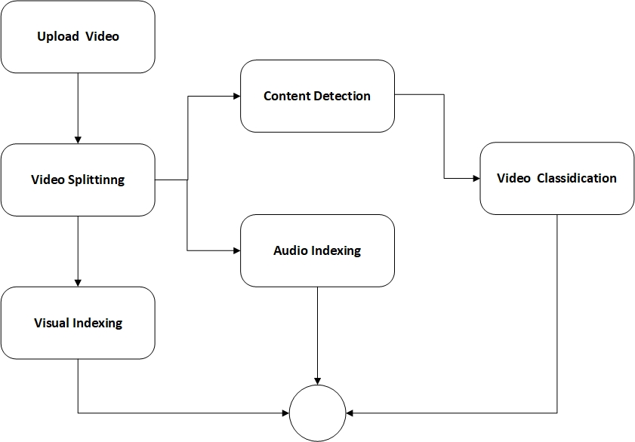
Proposed Solution

Slide 7
Project Scope
Video uploading
Video Splitting
Image processing
Video indexing
Audio indexing
Classification of the video

Slide 8
Project Objectives
Video Classification
Video Indexing

Slide 9
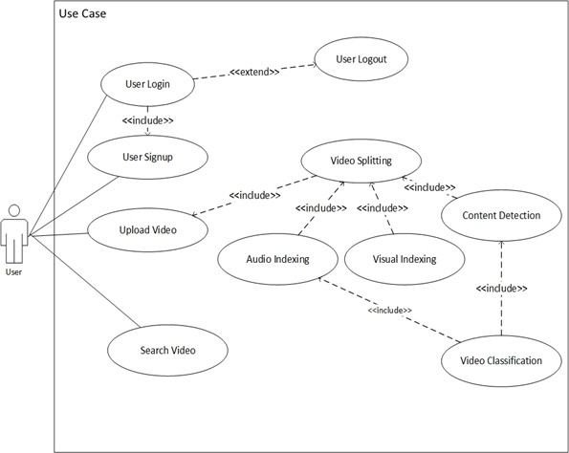
Diagrams…(Use Cases)
Notes:
All diagrams will be in PDF and their hyperlinks should be here to make it more visible

Slide 10
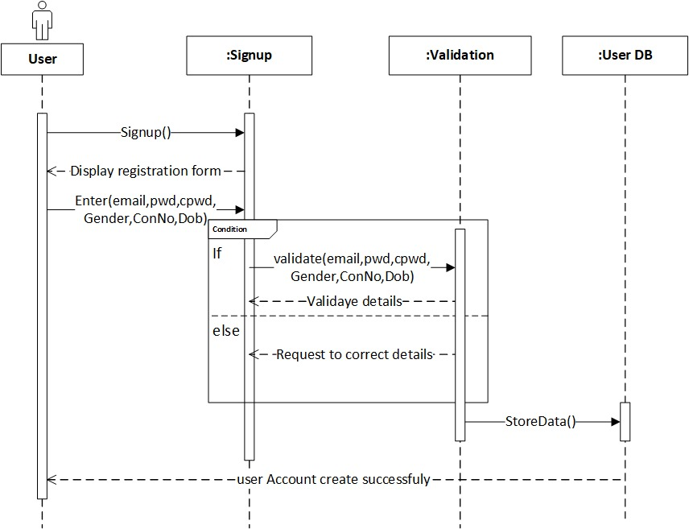
Diagrams…(Sequence)
Sign Up

Slide 11
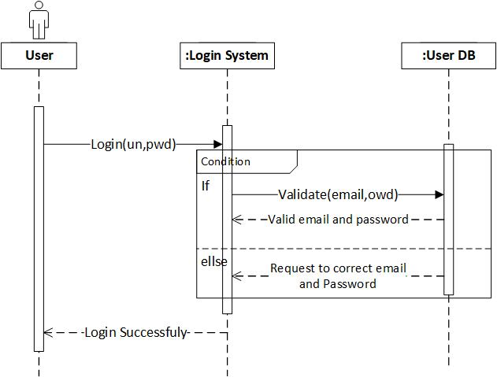
Diagrams…(Sequence)
Login

Slide 12
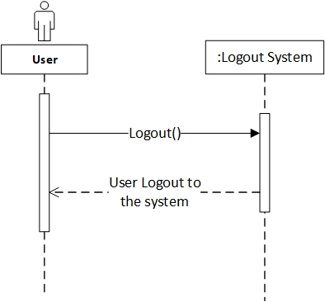
Diagrams…(Sequence)
Logout

Slide 13
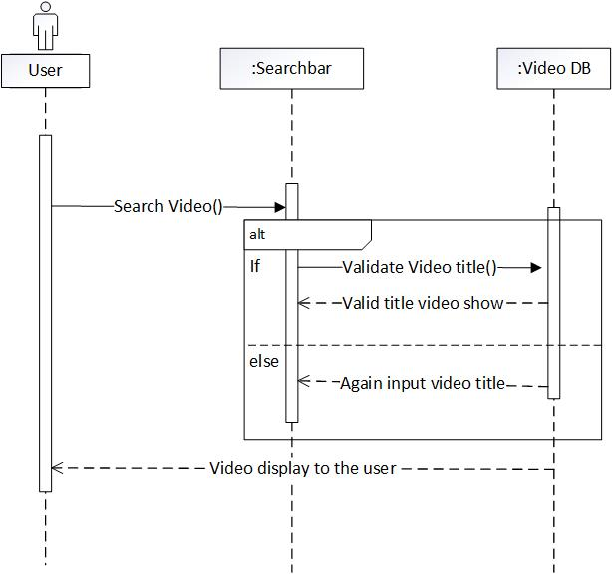
Diagrams…(Sequence)
Search video

Slide 14
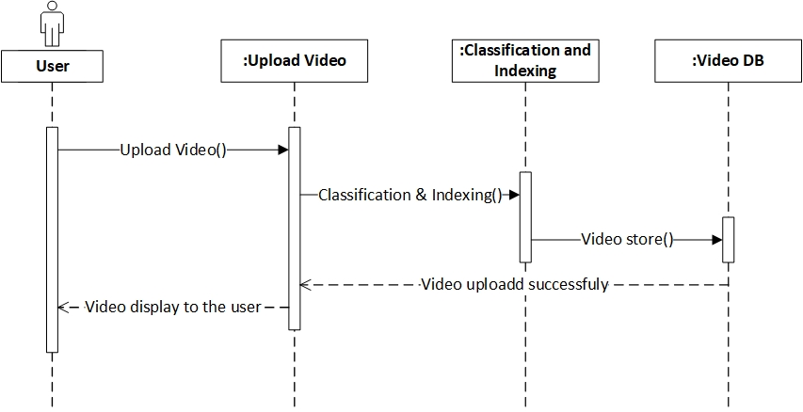
Diagrams…(Sequence)
Upload video

Slide 15
Diagrams…(Sequence)
Upload video

Slide 16

Diagrams…(Use Cases)
Notes:
All diagrams will be in PDF and their hyperlinks should be here to make it more visible

Slide 17
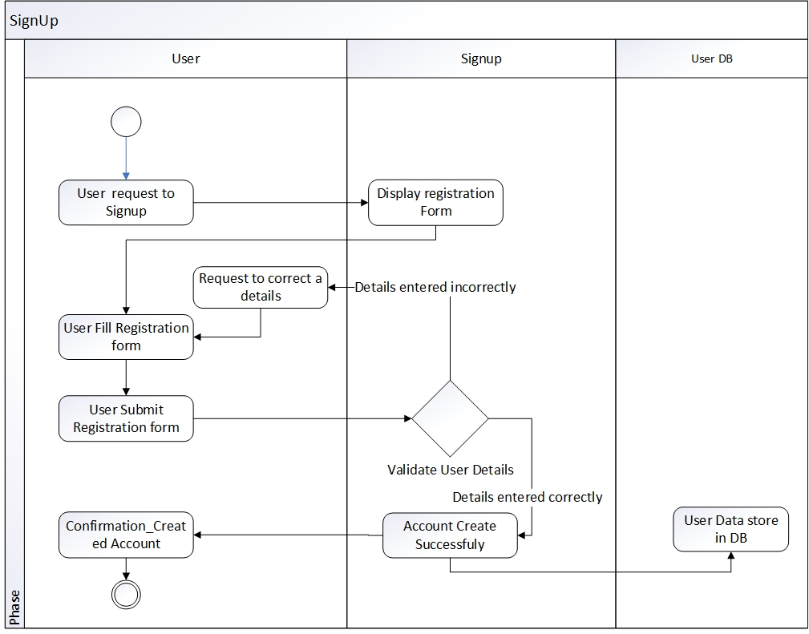
Diagrams…(Activity)
Sign Up

Slide 18
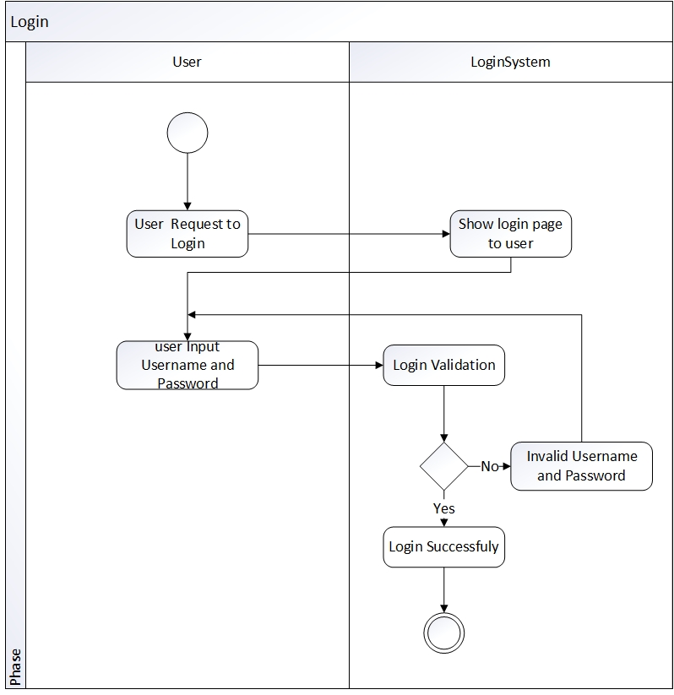
Diagrams…(Activity)
Login

Slide 19
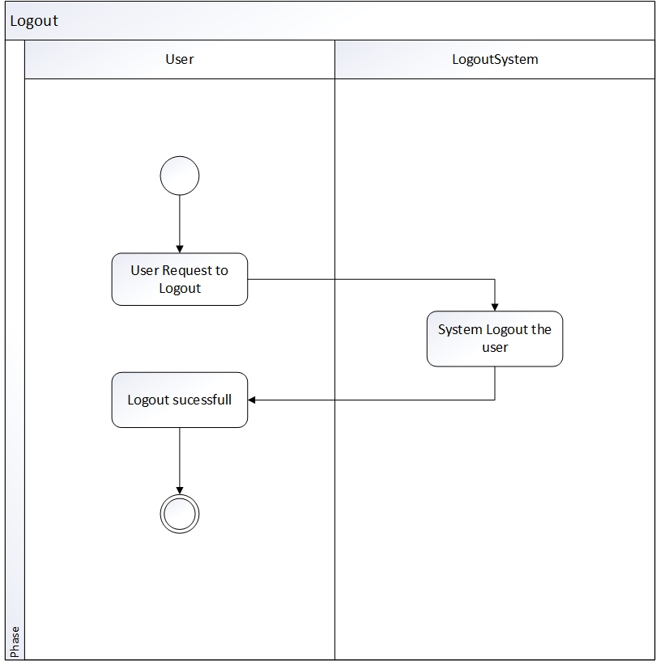
Diagrams…(Activity)
Logout

Slide 20
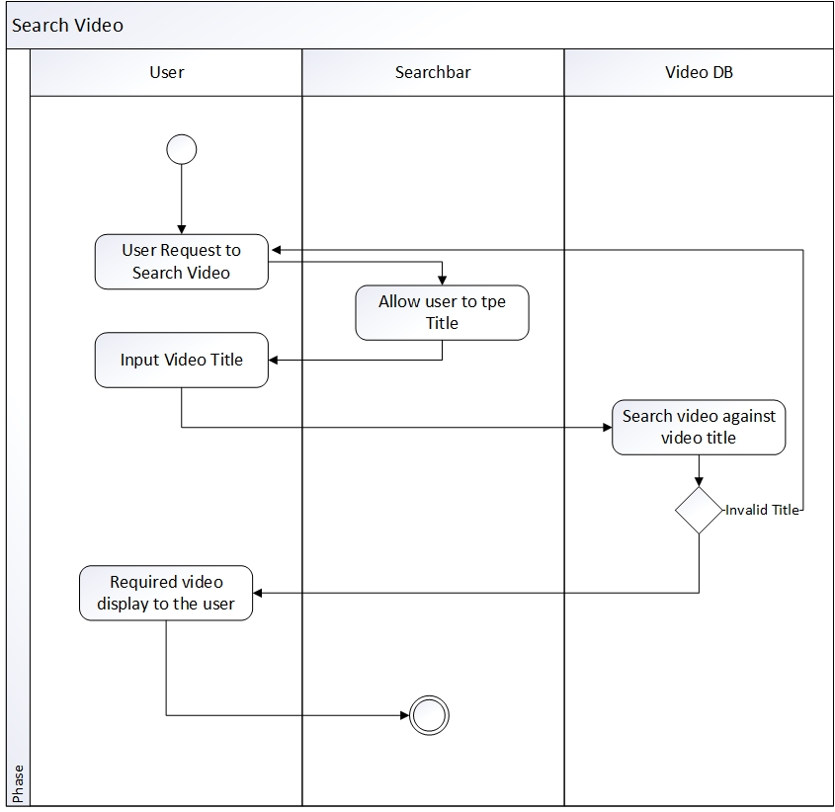
Diagrams…(Activity)
Search video

Slide 21
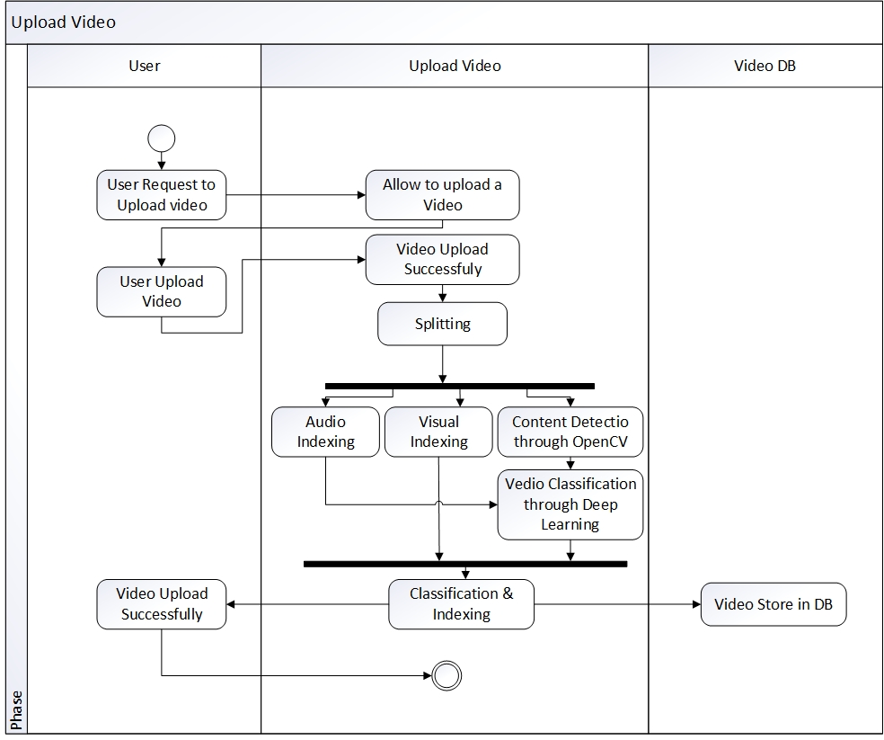
Diagrams…(Activity)
Upload video

Slide 22
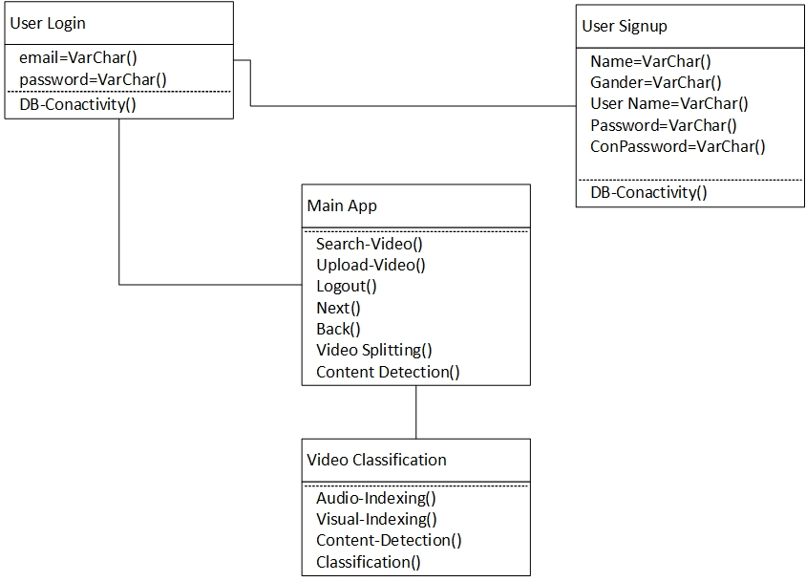
Diagrams…(Class)

Slide 23
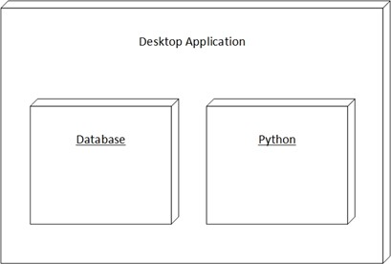
Diagrams…(Deployment)

Slide 24
Tools and Technologies
Tools And Technologies | Tools | Version
 | PyCharm | 2020.2.3
 | JUPYTER Notebook | 2020
 | WAMP | 3.2.3
 | Technology | Version
 | Python | 3.7
 | Machine Learning
 | Deep Learning
Notes:
Tools, Language, System Specs etc.

Slide 25
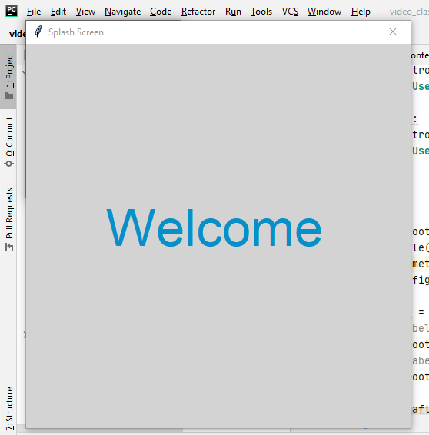
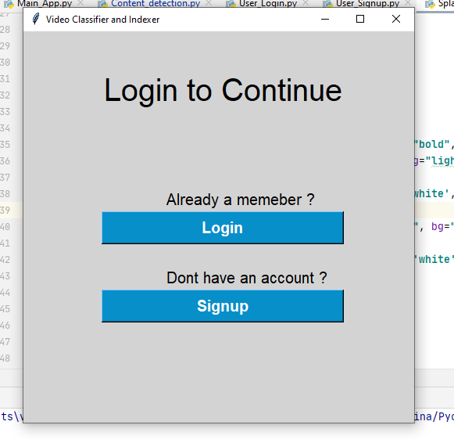
Screen Shots
Notes:
Few interfaces and should be in running form.

Slide 26
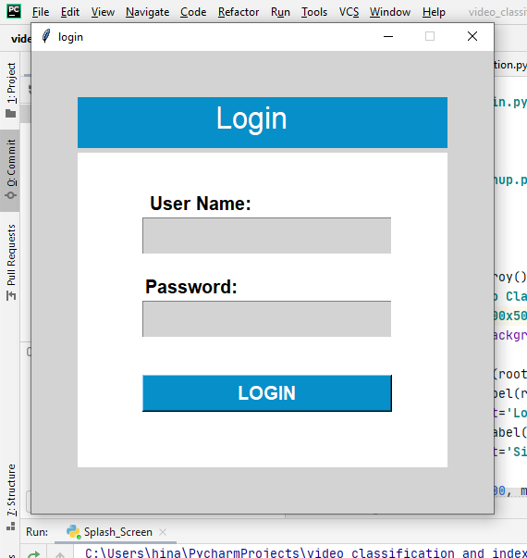
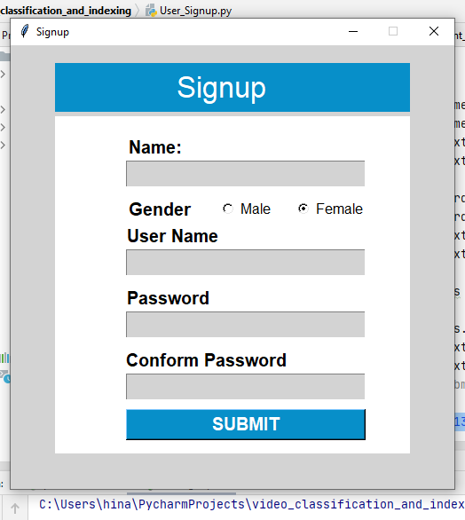
Screen Shots
Notes:
Few interfaces and should be in running form.

Slide 27
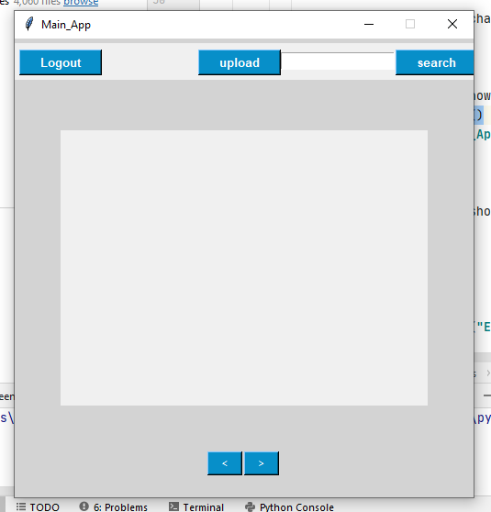
Screen Shots
Notes:
Few interfaces and should be in running form.

Slide 28


